Slide 1
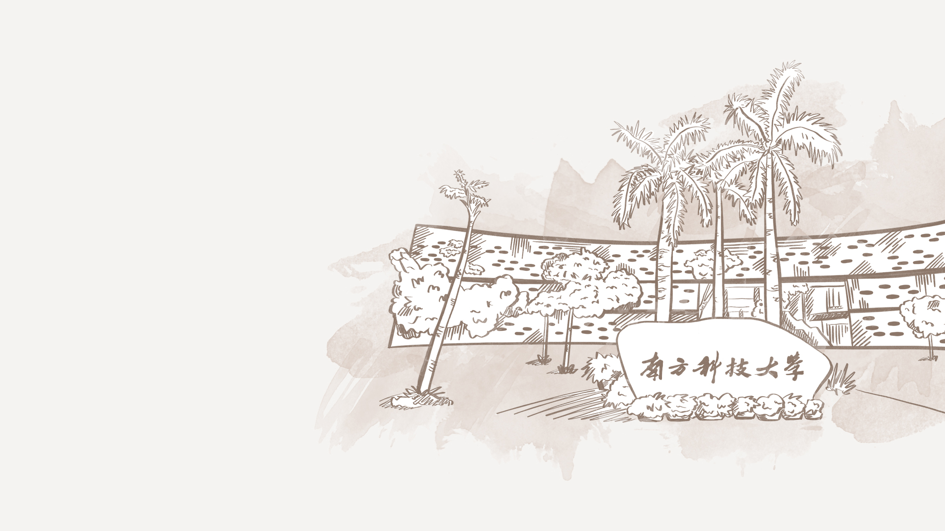

CS340 Final Project:
Depth to Fairness
陈驿来 黄杭

Slide 2
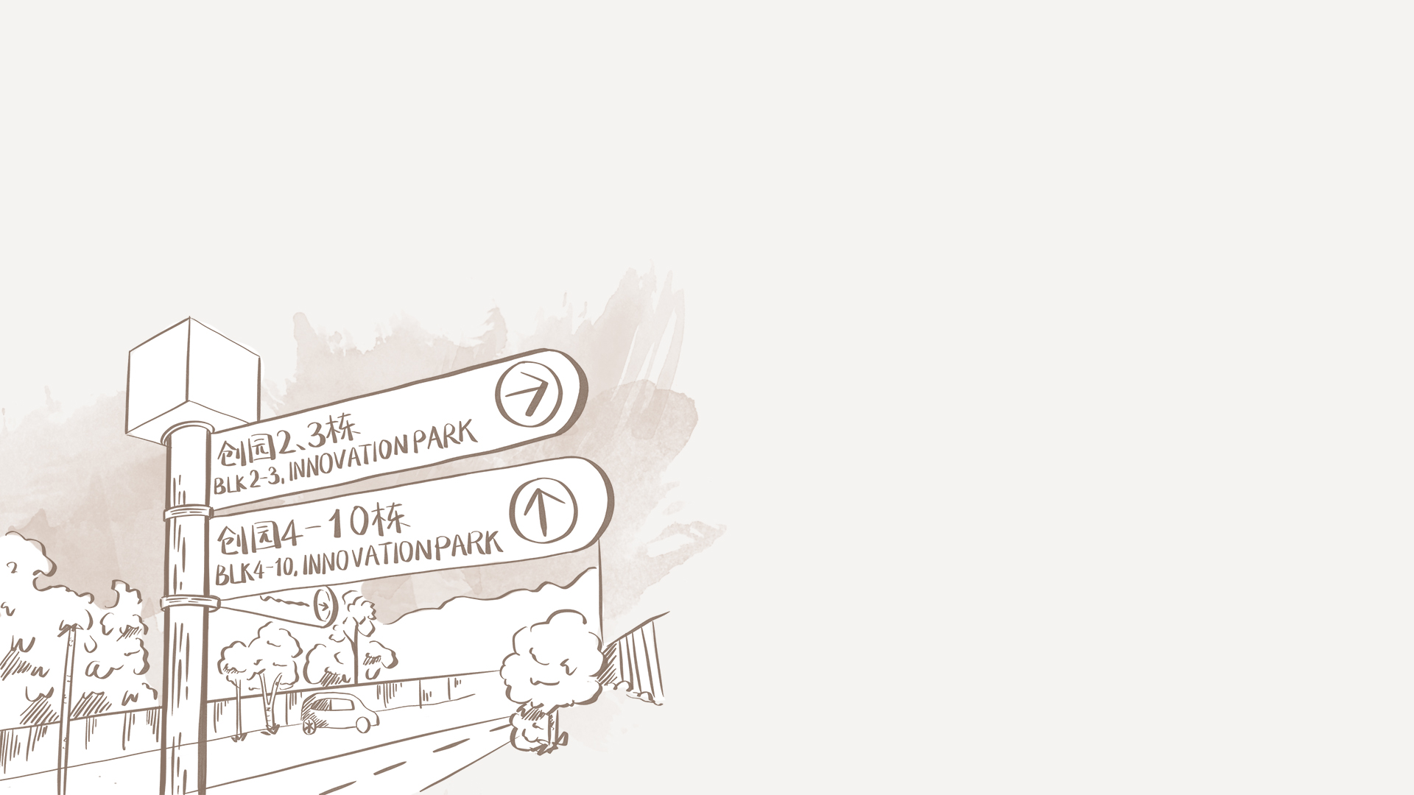
Table of contents
1. Model bias assessment using Demographic Parity
2. Mitigate bias from a variety of methods
3.
4.

Slide 3
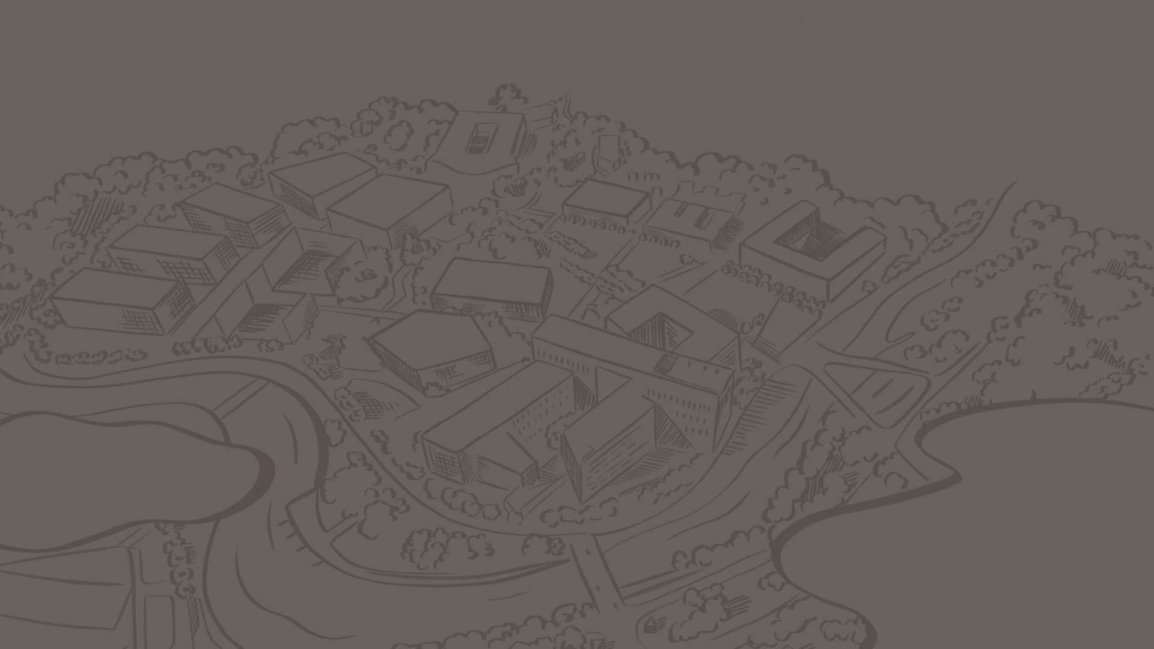


1
Model bias assessment using Demographic Parity

Slide 4

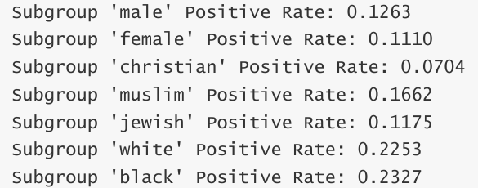
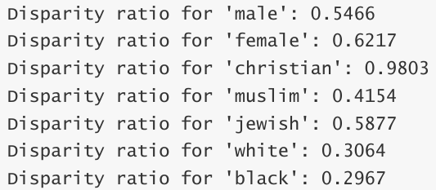
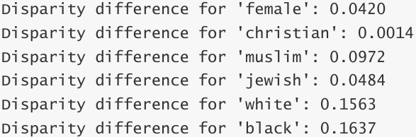
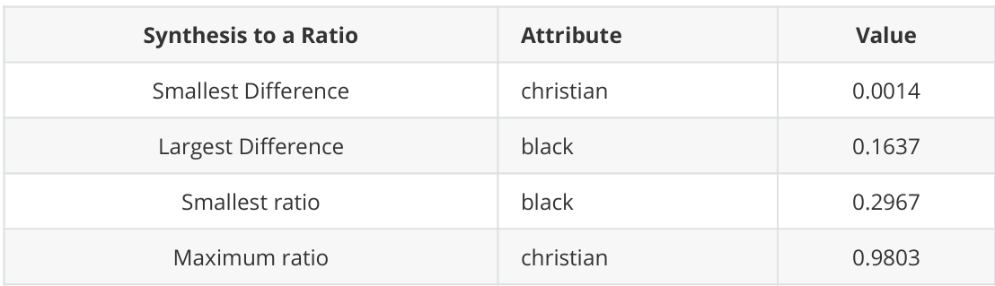
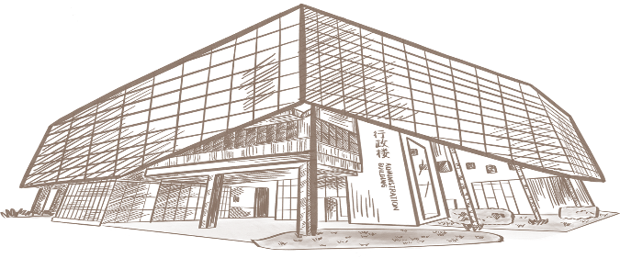


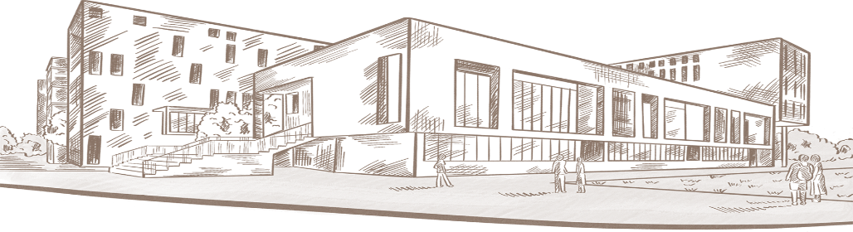
Model bias assessment using Demographic Parity
Here we use gender, race, and ethnicity as characteristics for bias assessment:

Slide 5
Model bias assessment using Demographic Parity
The difference between the Christian subgroup and the overall predicted positive proportion is the smallest.
The ratio of the positive predicted proportion to the overall positive predicted proportion is the largest.
The Christian subgroup, the deviation is minimal.
The difference between the black subgroup and the overall predicted positive class proportion is the largest.
The ratio of the positive class prediction proportion to the overall positive class prediction ratio is the smallest
There is a large deviation between the model's prediction and the overall prediction.

Slide 6
2
Mitigate bias from a variety of methods

Slide 7
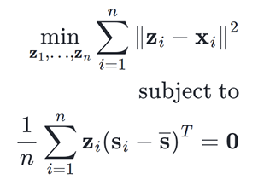
Preprocessing
To transform the data set to mitigate possible inequities in the data.
Preprocessing algorithms in Fairlearn follow the class sklearn.base.TransformerMixin, which means they can fit a preprocessing transform on a dataset.
The relevant values from the original dataset. We are particularly interested in the correlation between the "muslim", "black" columns and the three non-sensitive attributes 'severe_toxicity', 'obscene', 'identity_attack', 'insult', 'threat’.

Slide 8
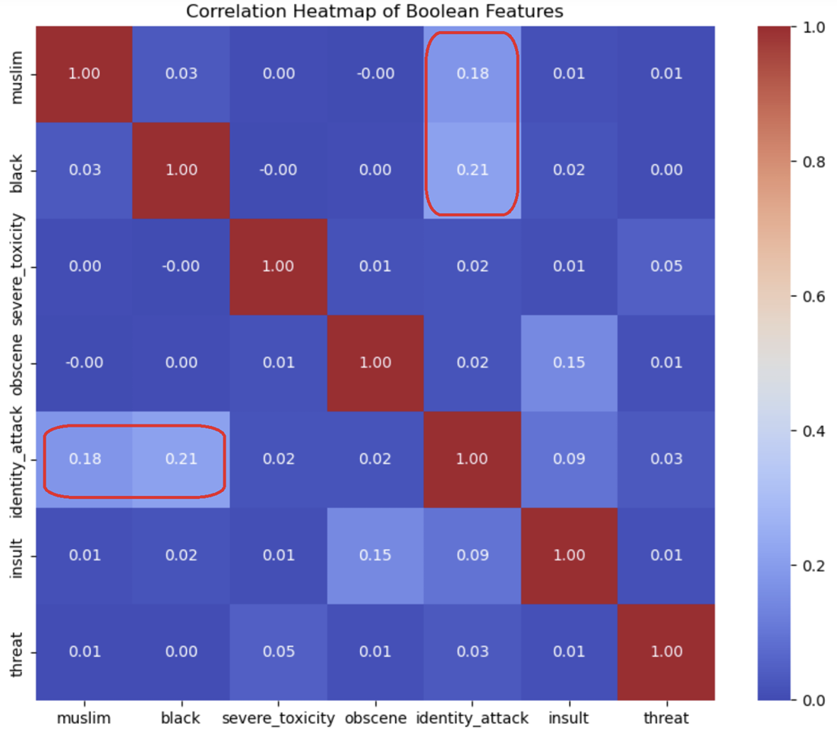
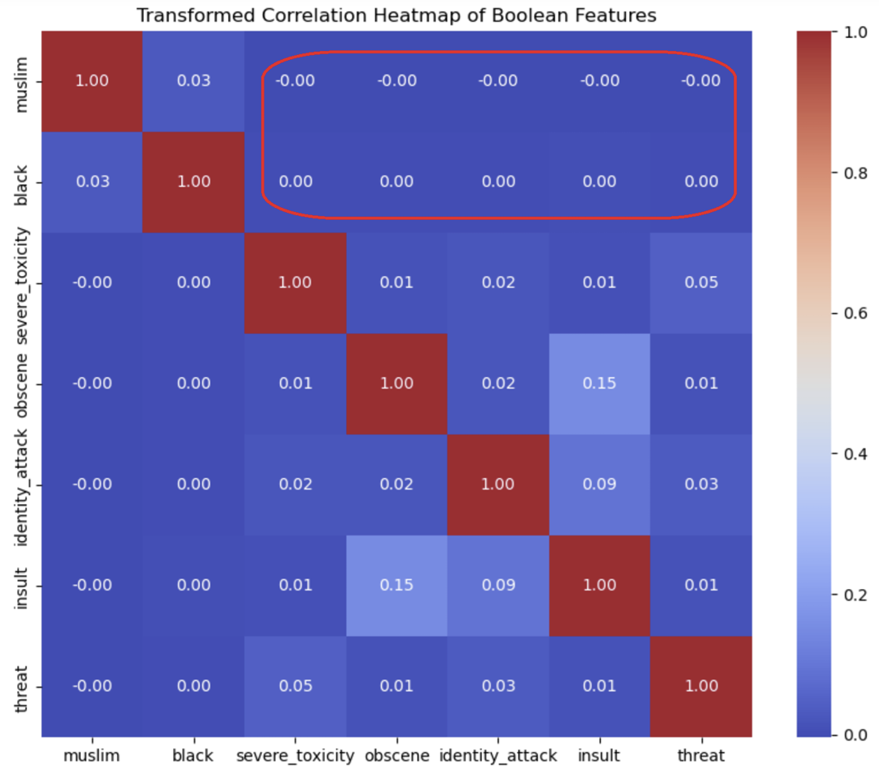
"identity_attack" has a high and abnormal correlation with "muslim" and "black", so our idea is to eliminate this phenomenon through Fairlearn.

Slide 9
3
Experiments

Slide 10
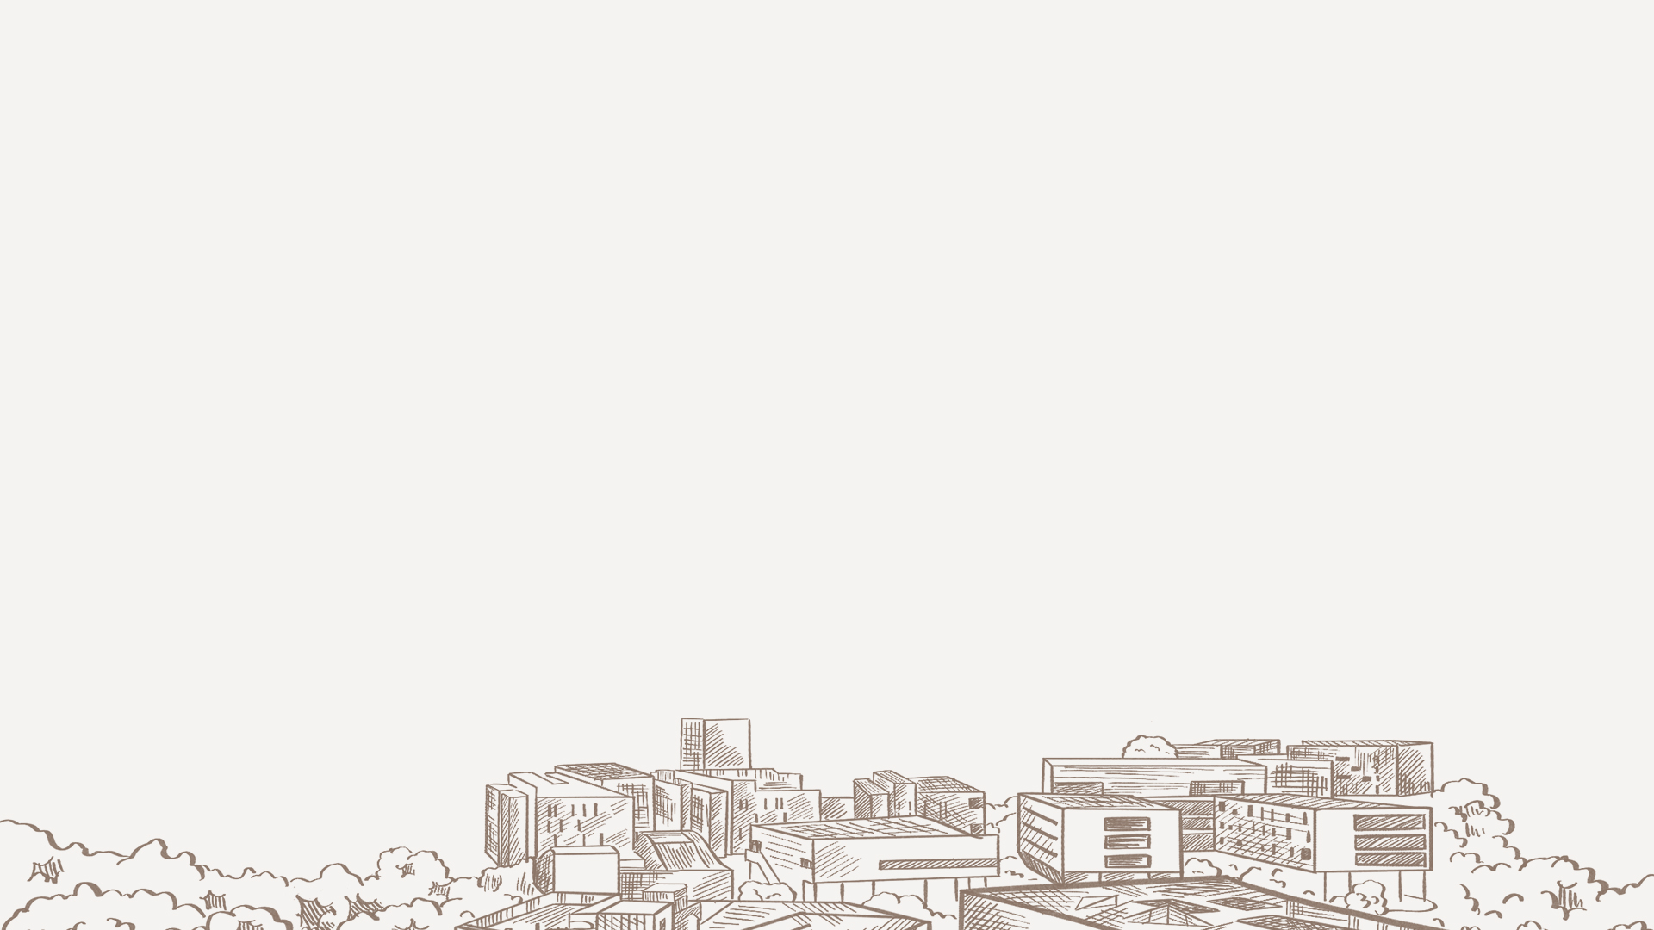

Slide 11


Slide 14


4
Conclusions

Slide 15
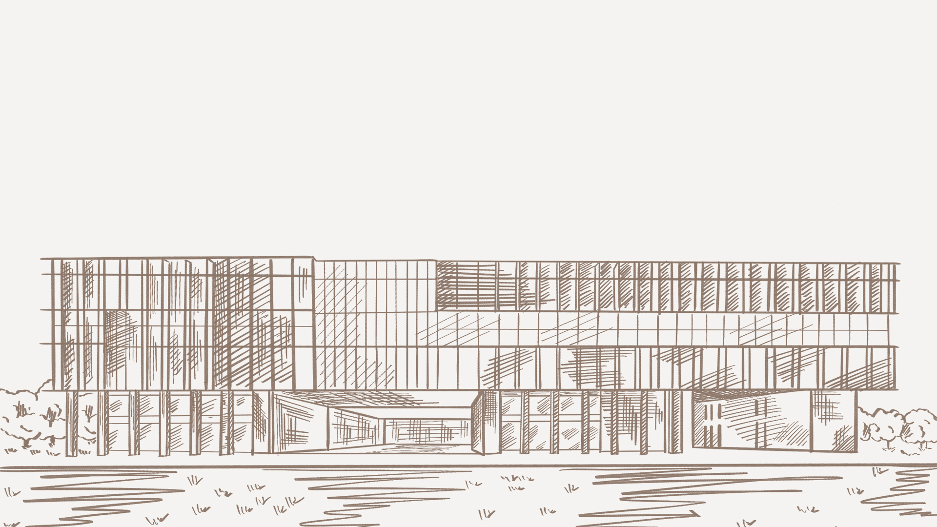

Slide 17
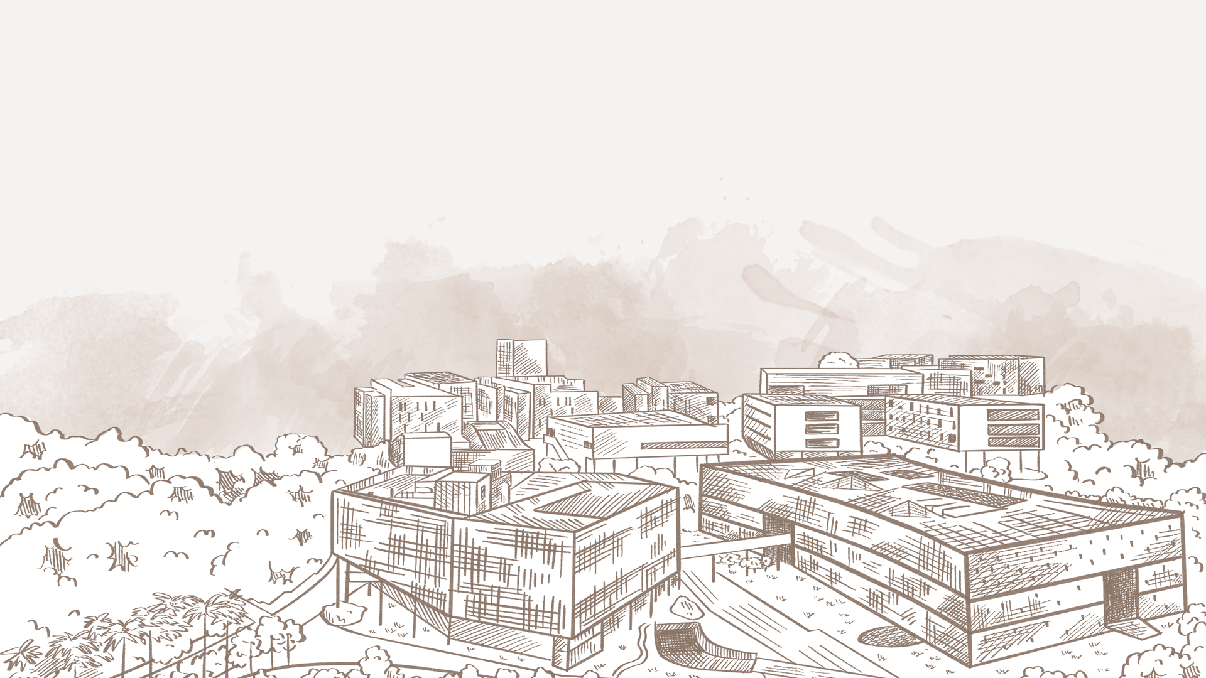
感谢
您的观看与收听

